Slide 1
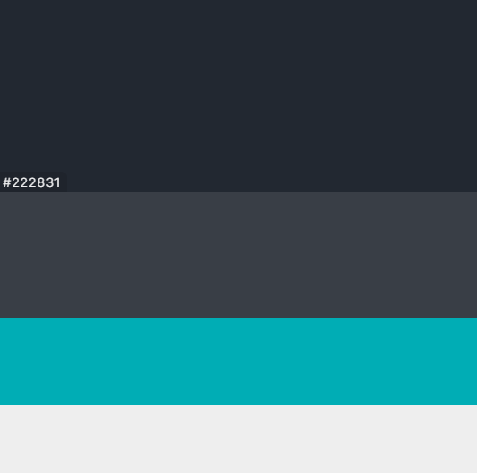












Slide 2


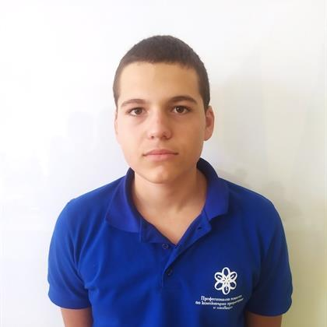
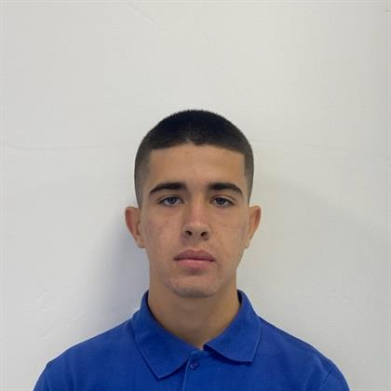
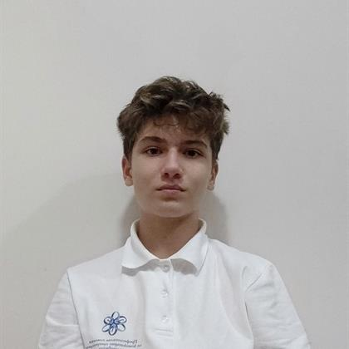
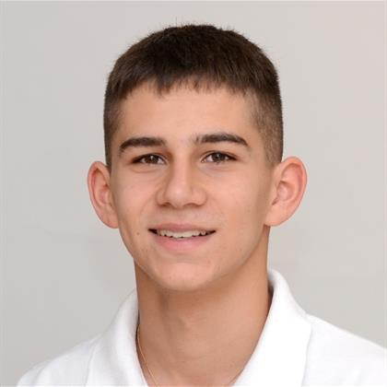
Our team
Todor Atanasov
Martin Nenkov
Scrum trainer
Designer
Aleks Kazakov
Ivan Dochev
Back-end developer
Back-end developer

Slide 3



The plan!

Slide 4











Used Technologies

Slide 5
Let’s jump to the code!

